Slide 1
Introduction to Computer
Likit Preeyanon
Microbiology and Molecular Genetics
Christopher Welcher
Computer Science

Slide 2
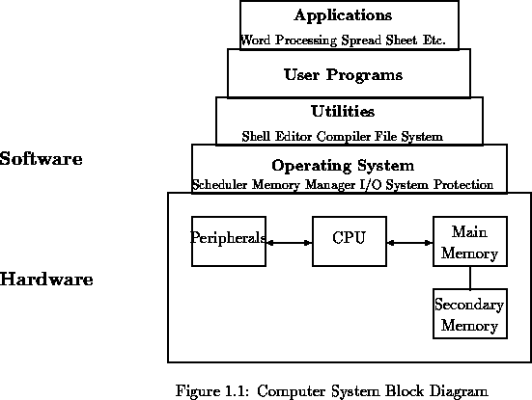
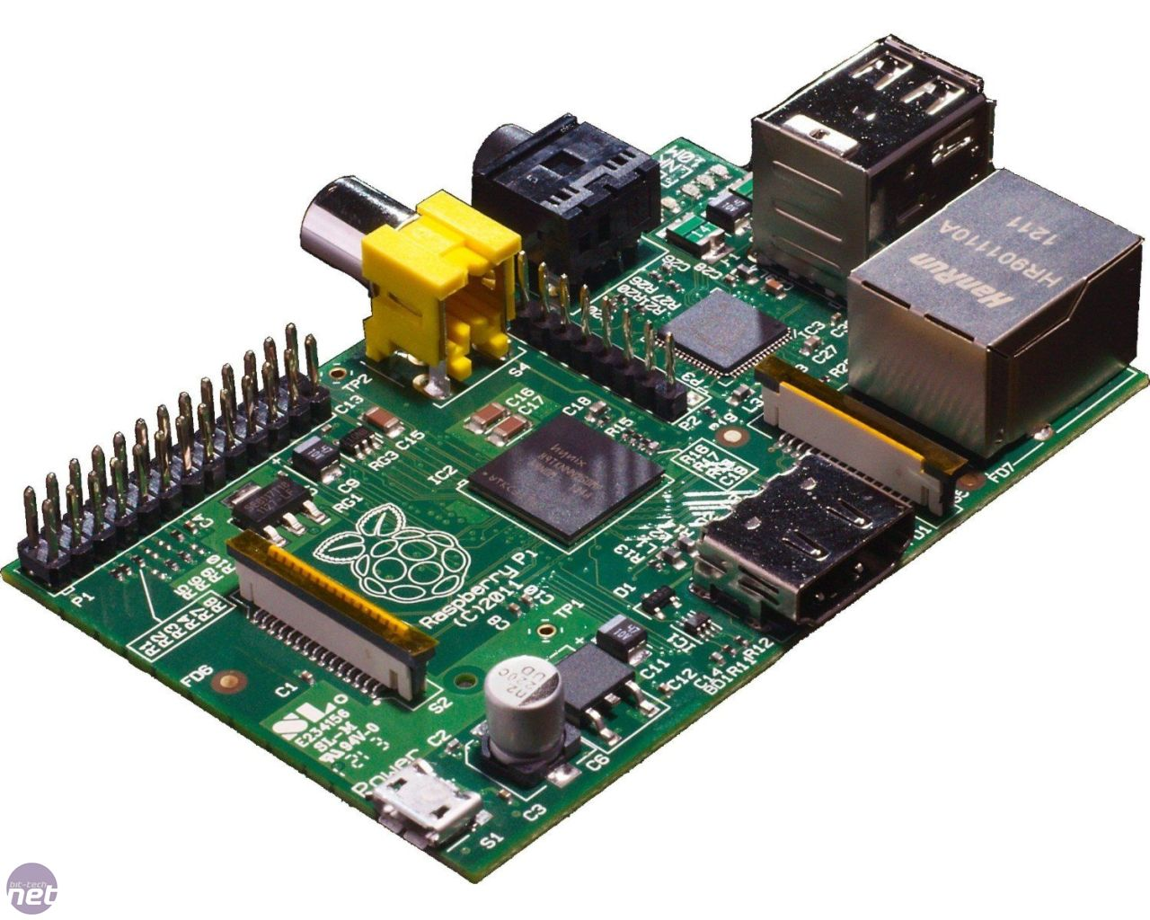
Computer System
Raspberry Pi
$45 from Amazon

Slide 3
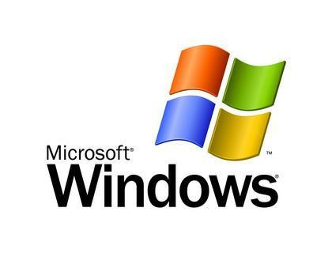


Operating Systems
Examples: Windows, Linux, OSX, UNIX
The “software that runs the software”
Manages the computer’s different components
Notes:
*manages all those devices like memory, hard drive, processor
*allows software programs to be run
*different goals might require different operating systems

Slide 4
Which OS to use?
Depends on what you need to do!
Proprietary vs. free
A lot of scientific computing relies on UNIX/Linux systems
UNIX-like operating systems include Linux, OSX
There are many distributions of Linux
Debian, Ubuntu, CentOS, Fedora, RedHat etc.
Example: The MSU compute cluster runs a version of Linux (RedHat)
Notes:
*OSX is actually just another UNIX system, with a tailored user interface
*Many programs are cross-platform, but some will be easier too install and use on one operating system than another
*For example, I find that Linux/UNIX systems are easier for general programming, because many of the tools are designed to interact directly with the operating system at a very low level

Slide 5
Disk and Memory

Slide 6
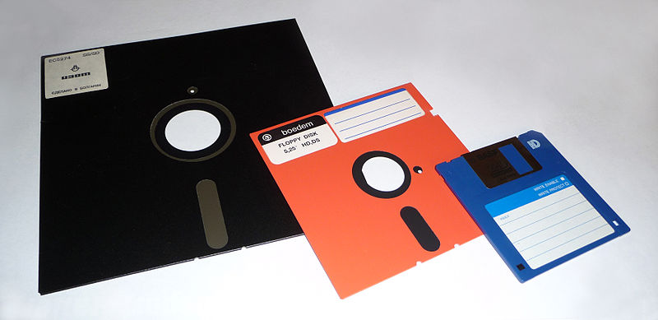
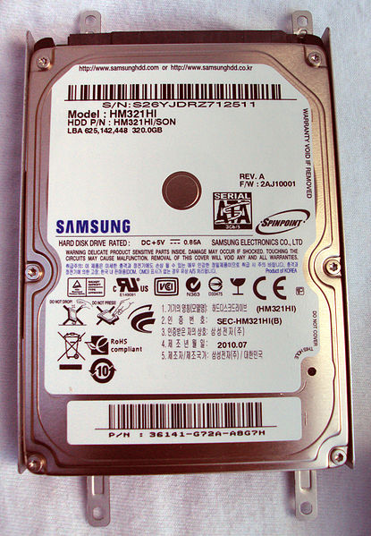
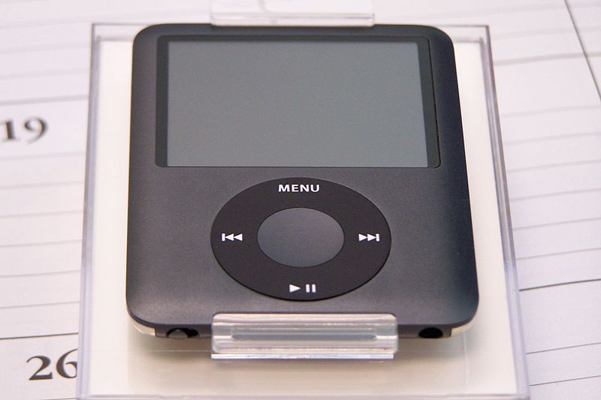
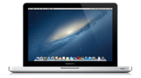
My Disk Storage Timeline
1992
1999
2008
2009
85 Kb – 1.4Mb
512 Mb
~100 songs
512 Gb
8 Gb ~2000 songs

Slide 7
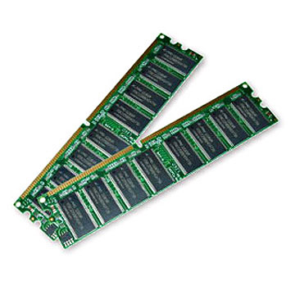
My Memory Timeline
1992 < 1 Mb ($36/Mb)
1999 256 Mb ($1.4/Mb)
2007 2 Gb ($0.082/Mb)
2009 8 Gb ($0.01/Mb)
2013 ($0.0054/Mb)
http://www.jcmit.com/memoryprice.htm

Slide 8
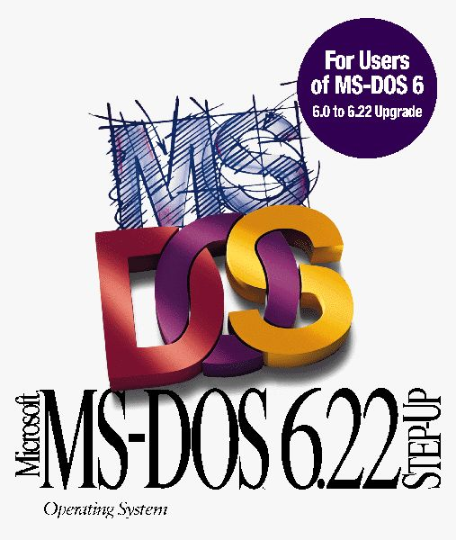

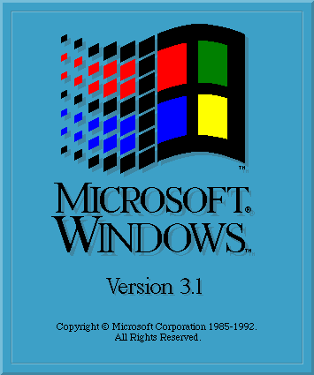

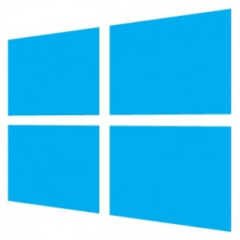
OS Minimum System Requirement
MS-DOS 6
Memory 256 Kb
Floppy disk 360 Kb
Mac OS 10.7
Memory 2 Gb
Hard disk space 8 Gb
Windows 3.1
Memory 1 Mb
Hard disk space 6.5 Mb
Ubuntu Linux
Memory 512 Mb
Hard disk space 5 Gb
Windows 8
Memory 2GB (64bit)
Hard disk space 20 Gb

Slide 9
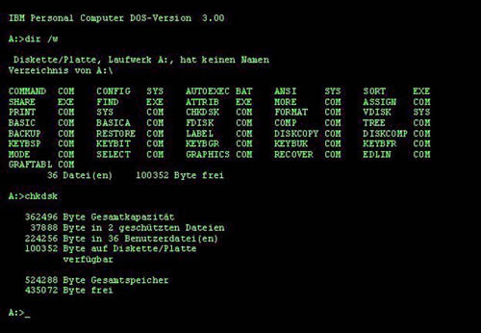
MS-DOS CLI

Slide 10
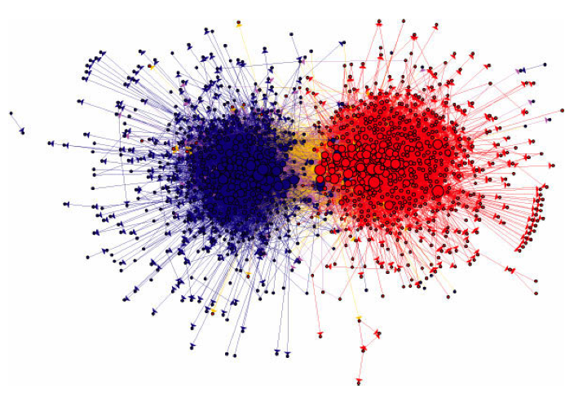
The Network of Political Blogs
http://www-ladamic/img/politicalblogs.jpg

Slide 11
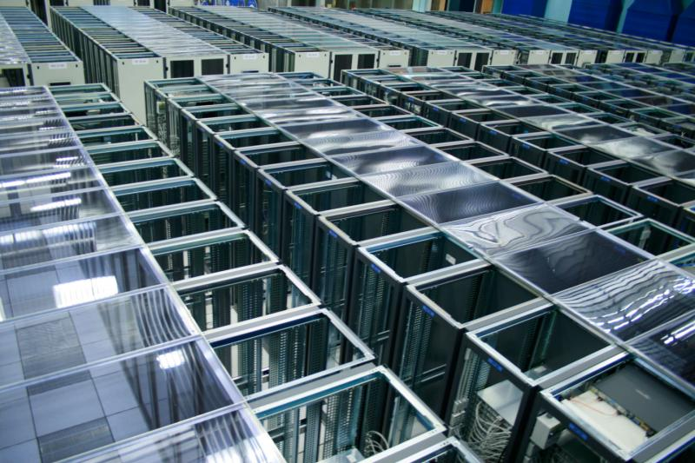
Large Hadron Collider data at CERN
75 patabytes (7,500 Gb) of data were generated in three years.

Slide 12
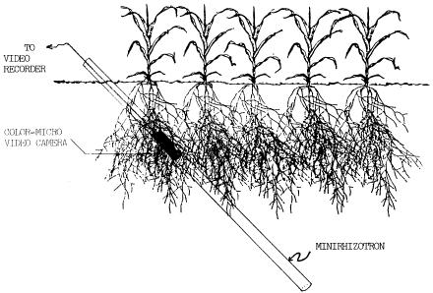
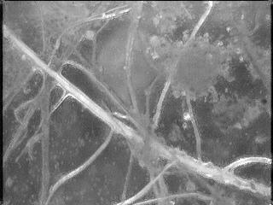
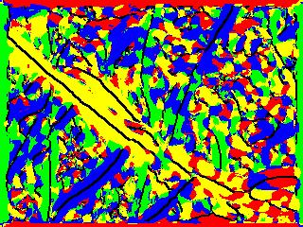
Root Image Processing Lab
1,000 photos/day

Slide 13
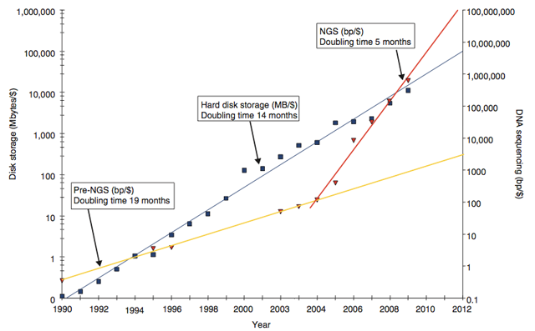
Disk Capacity and Sequencing data

Slide 14
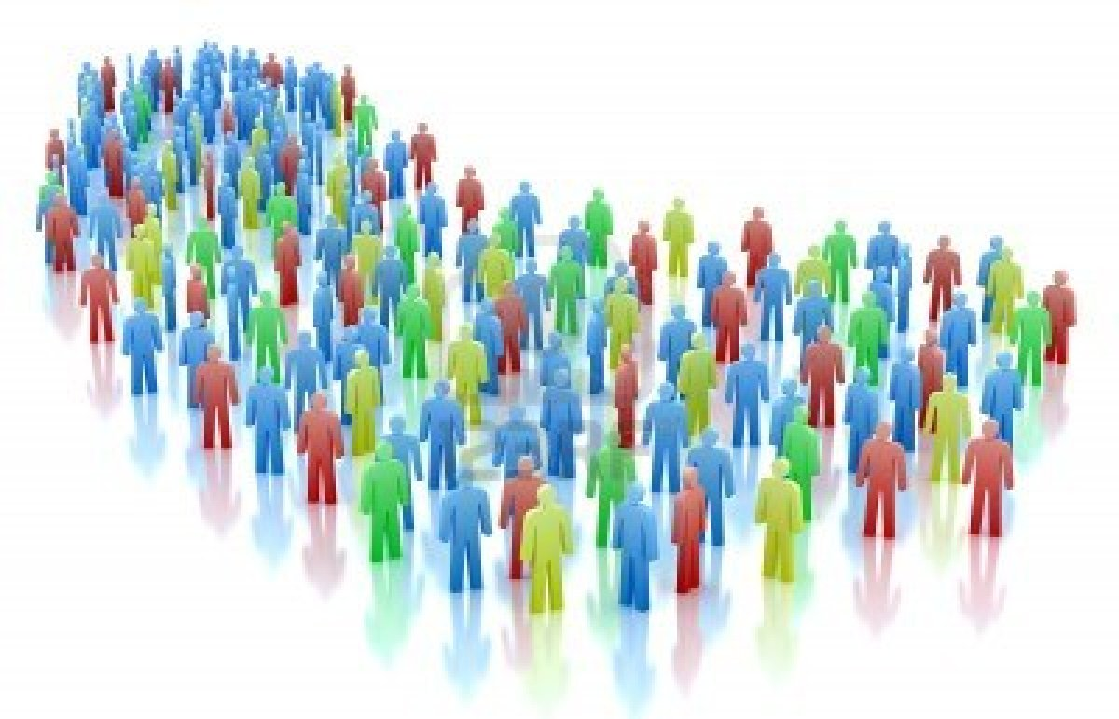
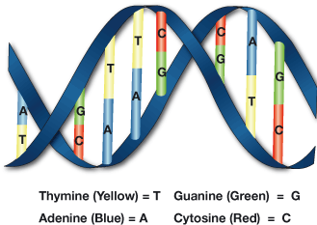
HapMap Project
x 20.6Gb*
~3.77 billion reads
*SRR002271 paired-end library, 40x coverage

Slide 15
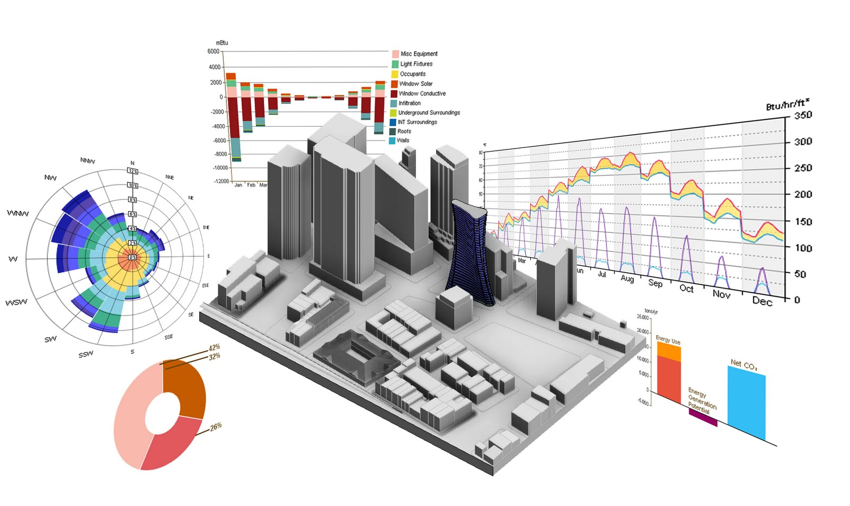
Can I analyze big data on my computer?

Slide 16
Algorithm
Single pass algorithm
Counting the number of elements/sequencing reads/words
Sequencing read alignment
Database search, BLAST search
Iterator (Python, C++, Java etc.)
Divide and conquer
Filtering

Slide 17

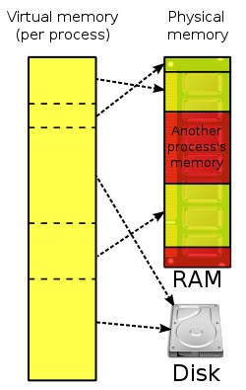

Virtual Memory

Slide 18
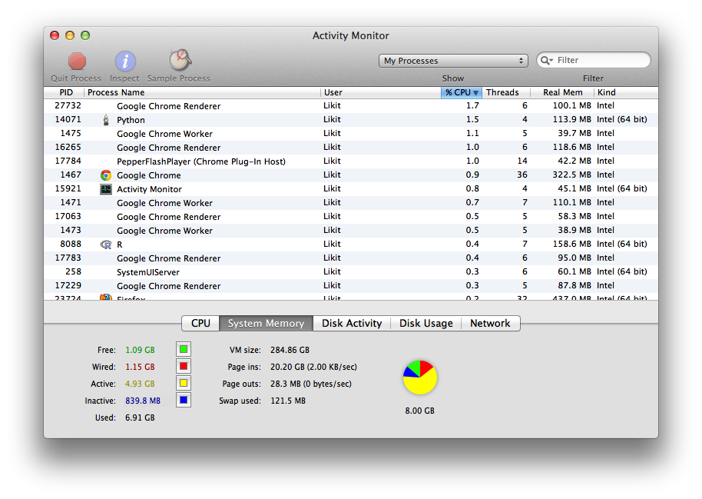
Activity Monitor

Slide 19
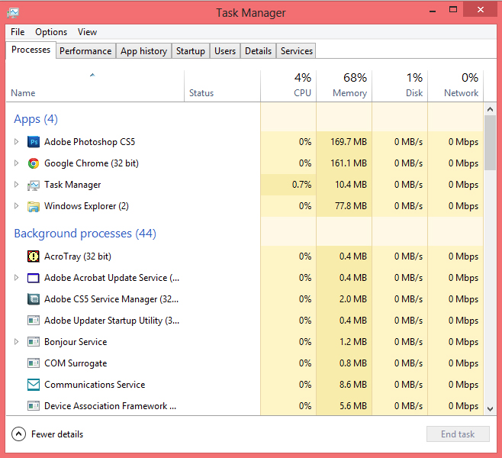
Task Manager

Slide 20
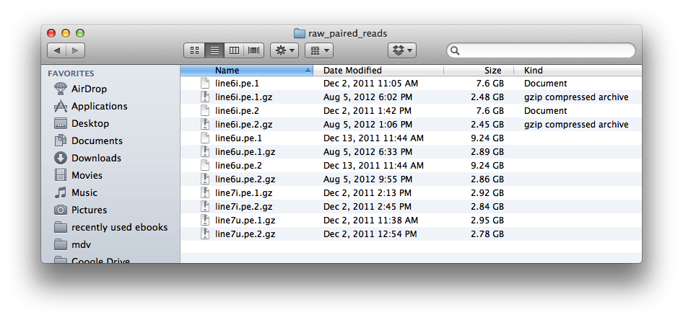
Mac OSX Finder

Slide 21
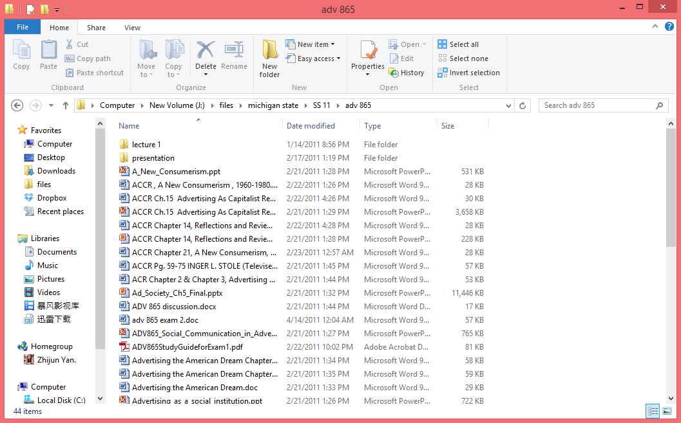
Windows File Manager

Slide 22
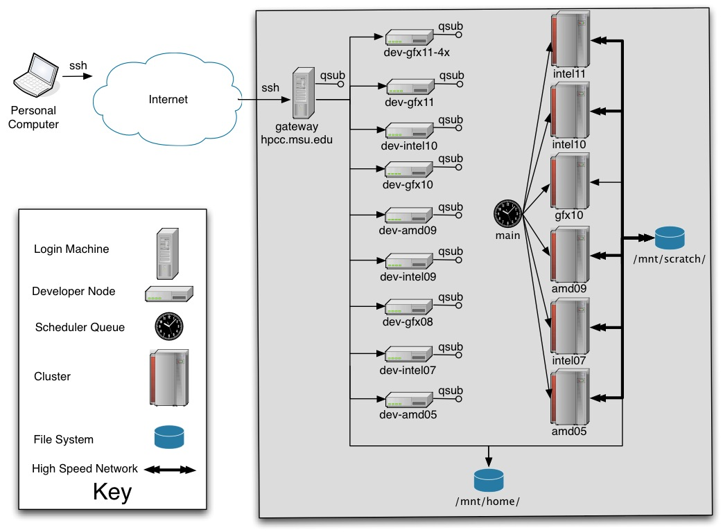
High Performance Computer Cluster
1 Tb memory
512 GB disk space
https://wiki.hpcc.msu.edu/display/hpccdocs/System+Information

Slide 23
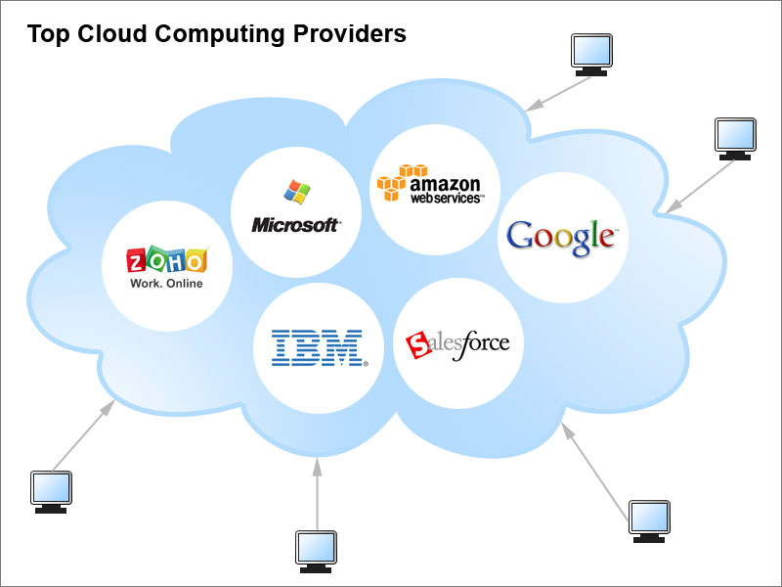
Cloud Computing

Slide 24

Transferring Files
Often times, it will be useful to transfer files over the internet
How long this takes depends on the size of the file and speed of the connection
Upload speed is usually slower than download speed
Notes:
Every internet connection has an upload and download bandwidth
Upload is when the file is leaving your computer to be copied elsewhere; download is when you receive a file from another location
Often times up speeds are slower than down speeds
Anything over ~2GB will take a while to download, and a very long time to upload
Can use compression to reduce file size for transfer

Slide 25
Transferring Files
HTTP, FTP, SSH
There are different “protocols” for transferring files
Some of the programs using these protocols will be introduced later
FTP: File Transfer Protocol
Used specifically for larger files
Will not speed up the transfer though
Notes:
Talk a bit about using FTP or SSH for large files
Make a brief mention of command line tools (FTP and SCP) which I believe are covered in the next part of the workshop

Slide 26
Navigating the File System
Files are organized by folders
Each drive is assigned a letter in Windows
A sequence of folders leading up to a file is the file’s path
Easiest to think of it as a tree
C:
\
\
Windows
Program Files
C:\Program Files
C:\Windows
Notes:
Above is a windows example
I suggest showing a demonstration of navigating to these locations through windows explorer

Slide 27
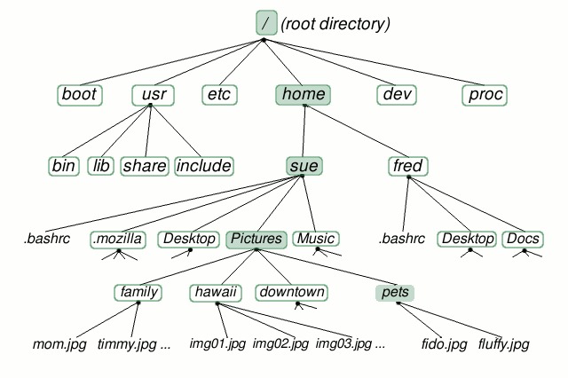
File Systems cont.
UNIX systems have a different convention
All paths start with ‘/’, which is the “root” of the file system
Directory names are divided using ‘/’ instead of ‘\’ as in Windows

